Slide 1
Drug designer database
Carlos Dominguez(Developer, Tester, everything…) Product Owner: Dr. Luis Arroyo

Slide 2
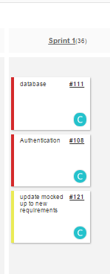
Stories in spring 1
Estimated
Actual
4 points
6 points
16 Points
13 points
16 Points
20 points
3 1 ---- ----- 39 13
Velocity =

Slide 3
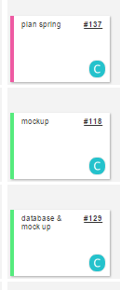
Mingle Daily Scrum
Sprint Planning: 4hrs
Mocked up = functional graphical user interface
GUI: 4hrs
Gui: 2hrs Database: 3hrs

Slide 4
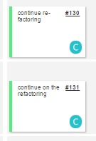
Mingle Daily Scrum
GUI: 3hrs Database: 2 hrs
GUI: 3hrs Authentication: 2hrs Meeting with client 1hr

Slide 5
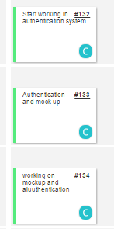
Mingle Daily Scrum
Auth : 4hrs Gui: 1hr
Auth : 3hrs Gui : 3hrs
Auth: 2hrs GUI: 2hrs

Slide 6
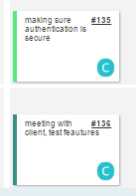
Mingle Daily Scrum
Auth: 2hrs GUI: 2hrs
GUI: 1hr Test: 2hrs Meet with Client: 1hr

Slide 7
Documents
Feasibility Study & Project Plan: not changed
Requirement: not changed
Design: added the ER diagram
User Manual : not changed
Installation and maintenance: not changed

Slide 8
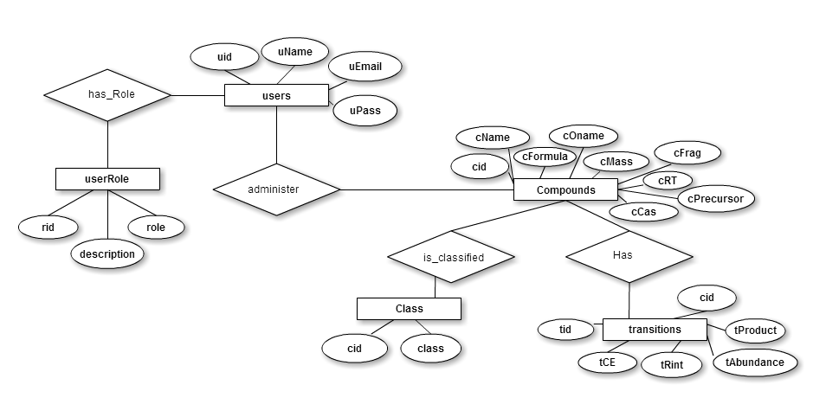
ER Diagram

Slide 9
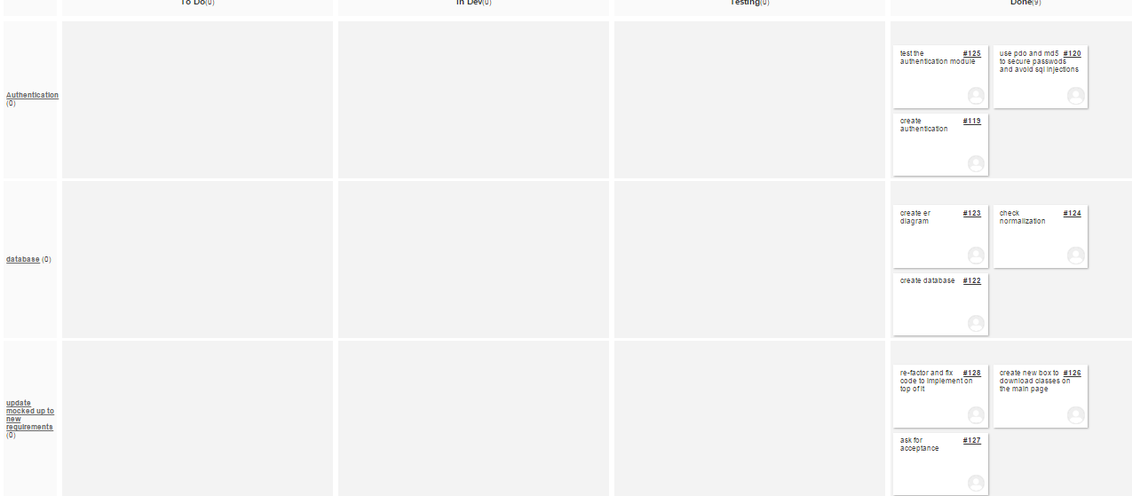
Spring Board
all task completed

Slide 10
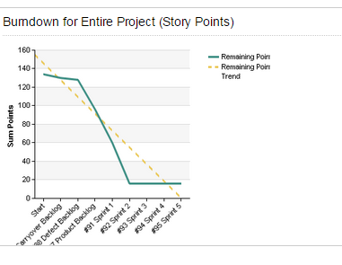
BurnDown Chart
All story points were finished

Slide 11
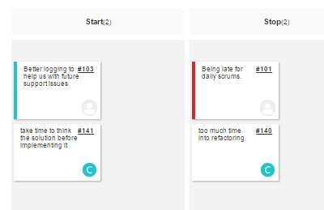
Retrospectives
Start:
need to write in words what I am going to do before doing it
Stop
need to spend less time into re-factoring and more time into coding other features

Slide 12
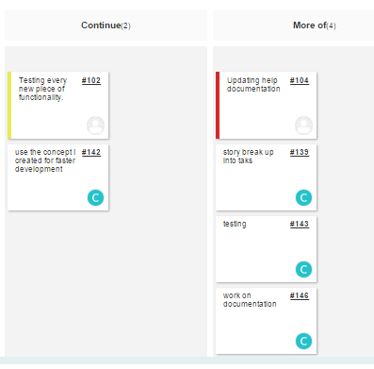
Retrospective
Continue
need to continue using the concept where there is a universal controller and add on on to it This serves for organization and structural purposes
More of
- breaking the story points into smaller tasks
- testing
Documentation

Slide 13
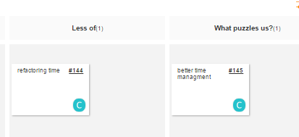
Retrospective
Less of: time in refactoring
What puzzles us? need to implement better time stimation

Slide 14
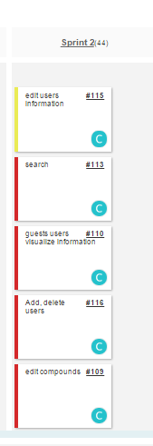
Current Sprint

Slide 15
DEMO

